Slide 1



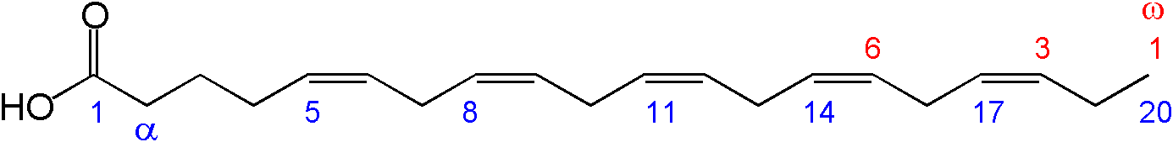
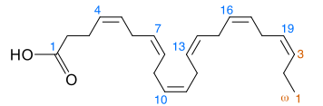
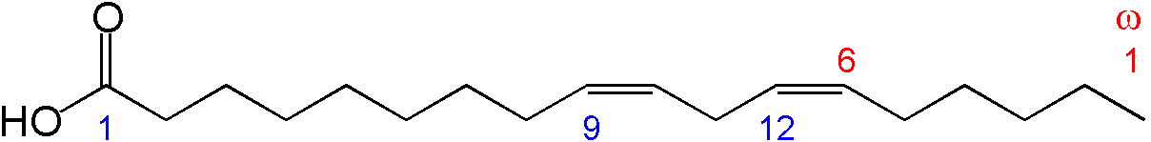
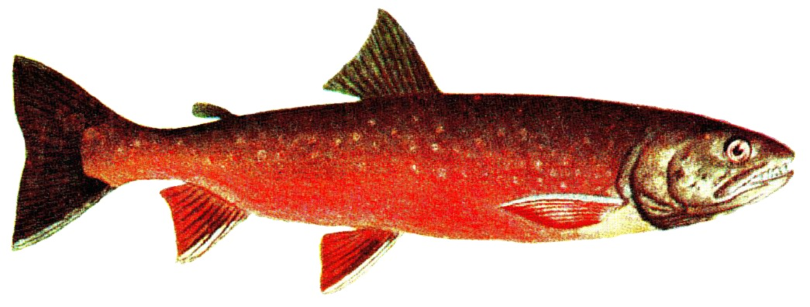
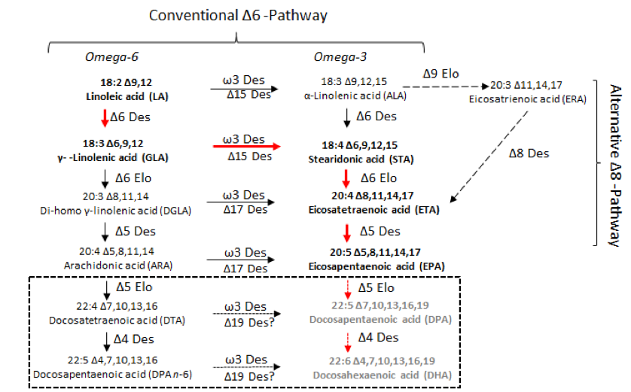
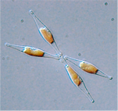
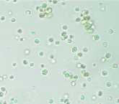
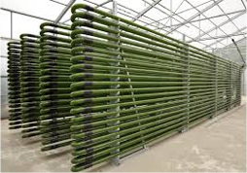
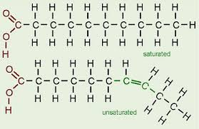
Stochastic modelling of fatty acid synthesis
Elahe Radmaneshfar ¹ (elahe.radmaneshfar@abdn.ac.uk), Oliver Ebenhoeh^{1,2}
¹ Institute of Complex Systems and Mathematical Biology and School of Medical Sciences, University of Aberdeen, UK
²Institute for Quantitative and Theoretical Biology, Heinrich Heine University, Düsseldorf, Germany
Essential fatty acids are those that are good for health but cannot be synthesized by mammals (including humans). The main source of these fatty acids (i.e. omega-3 and omega-6) are fishes, but overfishing causes severe ecological problems. One great source of these essential fatty acids are algae, however producing fatty acids from these micro-organisms in industrial scale requires detailed understanding of fatty acid biosynthesis in general. In this poster we will present the very first mathematical model which addresses the combinatorial explosion of pathways to synthesis fatty acids. This combinatorial complexity arises from the unspecificity of elongase and desaturates enzymes. Our stochastic model will predict the distribution of different fatty acids over time for given external conditions.
[1] Introduction
[4] Number of fatty acids of chain length N
Omega-3 and omega-6 are Long Chain Polyunsaturated Fatty Acids (LC-PUFAs). These fatty acids, especially EicosaPentaenoic Acid (EPA; 20:5∆5,8,11,14,17, n-3) and Docosahexaenoic Acid (DHA; 22:6∆4,7,10,13,16,19, n-3) are essential ingredient of healthy human diet. Their key roles are in the growth and development of infants and maintaining cardiovascular health in adults [1].
The number of of fatty acids of chain length N is equal to number of a binary strings of length N-3 without having consecutive ‘0’s. This is equal to the Fibonacci number F_{N-1}.
Eicosapentaenoic acid
Docosahexaenoic acid
Linoleic acid
Salmon is a rich source of EPA.
[5] Pathways for the biosynthesis
of LC-PUFA in p. tricornutum
Fishes are the current main source of these essential fatty acids. Overfishing causes the depletion of wild fish stocks and pollution of the marine environment [1]. Therefore there is an urgent need for alternative, sustainable sources of omega-3 and omega-6 LC-PUFAs.
Microalgae and diatoms are the primary producers of LC-PUFAs in the aquatic food chain. They have been demonstrated as promising alternative sources to fish oils for the cultivation of EPA- and DHA. Algae do not compete with food crops for arable land. Their growth rate and productivity is very high. They can grow in a controlled growing condition, i.e. in fermenters or closed photobioreactors.
Pathways for the biosynthesis of LC-PUFAs in P. tricornutum. The predominant route for the biosynthesis of EPA is shown with red arrows and in bold text, along with other minor routes described by Arao and Yamada[2]. The predicted pathways for the biosynthesis of DHA are within the broken lined box and the expected most active route is shown with red broken arrows and with text in grey [1].
From left to right:
Phaeodactylum tricornutum
Nannochloropsis gaditana
Photobioreactor
Phaeodactylum tricornutum is a unicellular diatom which accumulates EPA (up to ~35%), but only trace levels of DHA. Considered a good source for the industrial production of EPA, it also grows quickly, is easy to genetically transform and has a fully sequenced genome, making it an appealing system for further study.
[2] Principle of fatty acid biosynthesis
[6] Enzyme unspecificity results in combinatorial explosion
The input to fatty acid synthesis is acetyl-CoA , which is carboxylated to malonyl-CoA.
Acetyl CoA + CO2 Malonyl CoA
Elonagation is the process of adding two carbon atoms to a fatty acid chain by using an elongase enzyme.
2NADPH + 2H⁺ + Malonyl CoA + long chain Fatty Acyl CoA Fatty Acyl CoA lenghthed by two carbons
Desaturation is the process of introducing a double bond between two carbons at a specific position using a desaturase enzyme.
RCH₂CH₂...CH₂COSCoA + NADPH + H⁺ + O₂ RCH=CH...CH₂COSCoA + NADP⁺ + 2H₂O
A variety of unsaturated fatty acids can be formed by a combination of elongation and desaturation reactions.
1. Choosing between elongation and desaturation is a random process and is proportional to the ratio between the availability of the of the elongase and desaturase enzymes.
2. The position for introducing a double bond is also a random variable.
1111 111111 110111 110101 11110101 01110101
The process continues until the maximum length and desaturation are achieved.
[7] Simulation results
The simulation has been performed for a system with 200 molecules of unsaturated FA of length 6, i.e. ‘111’. At this stage the maximum chain length has been assumed to be 12. The simulation for each single molecule has been performed 200 times to calculate the average behaviour. Furthermore, the ratio between availability of elongase and desatures enzymes has been varied {0, 0.1,0.2,0.3,…,0.9}, ‘0’ means there is no desatures present. The figure shows the distribution of the attractor fatty acids for the different ratio between availability of elongase and desaturase enzymes.
[3] Model
Representation: Single bonds between individual carbon atoms of the fatty acid chain is represented by ‘1’ and double bonds are being represented by ‘0’. A fatty acid of chain length ‘N’ is being represented by ‘N-3’ ‘1’s and ‘0’s.
Left: Representation of saturated fatty acid in our model, right: representation of unsaturated fatty acid in our model
1 1 1 1 1 0 1
[8] Future work
1 1 1 1 1 1 1
Use Gillespie algorithm to compute time evolution trajectories.
Expand the model for an open system in which fatty acids can be created and degraded.
Rules:
Desaturation change the status of a bond from ‘1’ to ‘0’.
A carbon can just have one double bond (i.e. no two consecutive zeros are allowed).
Carboxyl and methyl carbons cannot have double bond.
References:
[1] M.Hamilton et al 2014, Metab Eng., 22(100):3-9
[2] Arao T., Yamada M. 1994, Phytochemistry, 35:1177-1181

